Slide 1

WAYPOINT
Your Campus Companion
Notes:
Remember your first week at UQ? Wandering around lost, missing events, not knowing where to even find help or food? We’ve all been there. What if finding your way — and discovering UQU — was as easy as lifting your phone? What if we had Waypoint by UQU?

Slide 2
Our Problem
UQ Maps
Google/Apple Maps
Currently UQ’s own map application is being received poorly due to various bugs and inaccuracies that prompted the creation of this project. With its reviews averaging 1.4/5 stars.
While Google and Apple offer better services than the custom UQ map, they lack the accuracy and personalization required for a campus specific navigation app.
“I’m a first year undergraduate and was really relying on this app to help me but it just made me more lost. Your location dot doesn’t update or show the direction you are facing.”
- Chloe_King1 (App Store Review)
“When i first started at UQ I tried to use Google maps to navigate the campus but often got lost as the map was not accurate enough”
- Macsen Cunninghame (Interview)
Notes:
Currently campus navigation solutions like UQ maps and Google Maps just aren’t cutting it for students like Chloe and Macsen. They lack accuracy, relevancy and efficiency.

Slide 3
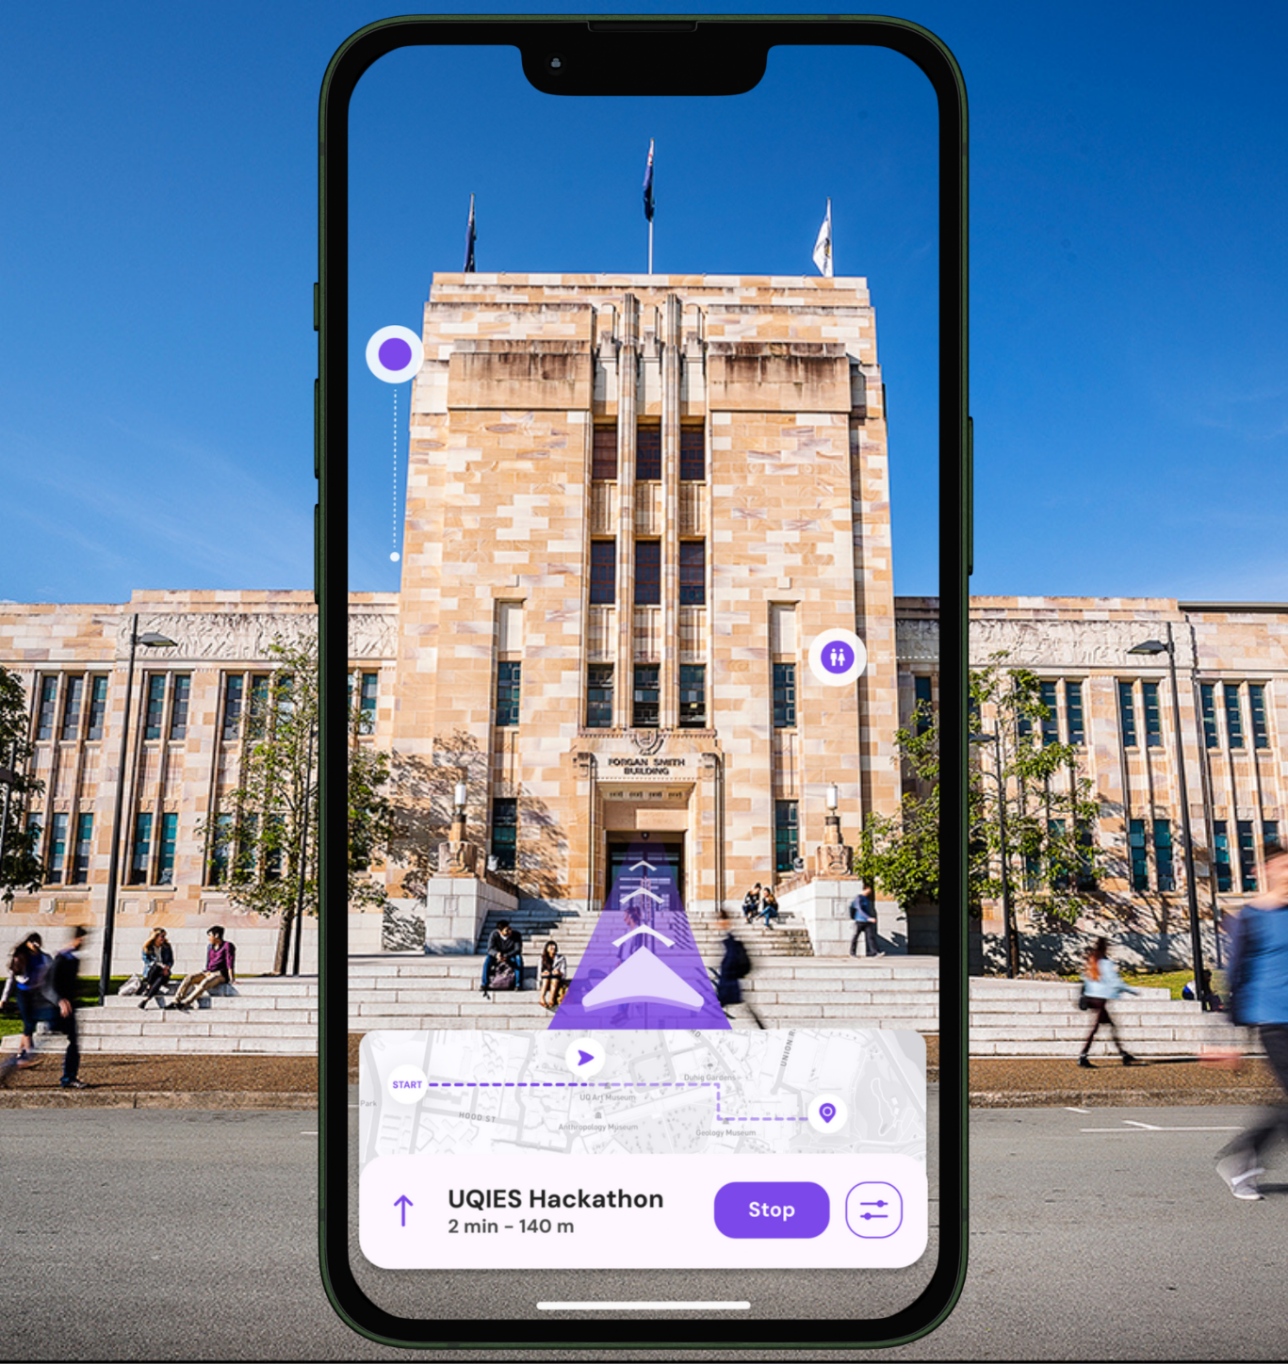
The Solution!
Why Waypoint?
Solves the campus-wide navigation problem
Utilises AR to provide navigation, promotions and suggestions
Support for accessible routes
Various pages and features dedicated to UQU services to ensure everything students need is in one app.
Uses stripe for payment management with automate fund management straight to event organisers and clubs
AR Navigation Geolocked to St Lucia, Gatton and Herston Campus’
Notes:
So students need waypoint, the UQU app aimed at solving real student problems like campus navigation. Currently 62% of students are unaware of UQU services, this is why waypoint merges UQU services with a solution to a campus epidemic. Waypoint works by utilising AR technology to overlay directions to help guide users while also promoting UQU services like events to promote users to engage in the community.

Slide 4
The UQU Hub
Student Support Appointment Booking
In-App Club and Event Sign Up
Store and Event Coupons
AR Open day and O-Week Events and Tours
Integration With Student Timetables
UQU AR Event Promotion
Notes:
So what services does Waypoint offer? Well our aim is to deliver all that uqu has to offer and more like in-app club and event creation and registration and AR event promotion.

Slide 5
The UQU Hub
Club and Event Push Notifications
Stripe Secure and automated payments
Volunteer Signup
Digital distribution of Semper Floreat
Notifications of nearby popups or gatherings with directions
Notifications of Nearby Popups and Gatherings
Notes:
More notably, interviews with UQU also unveiled the need for push notifications and stripe payments.

Slide 6
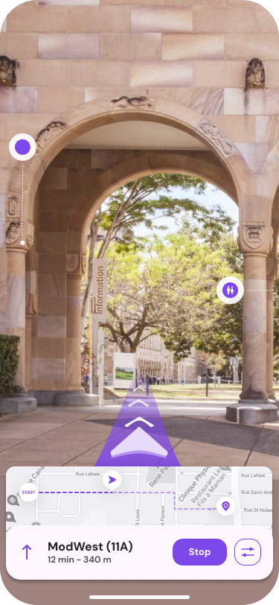
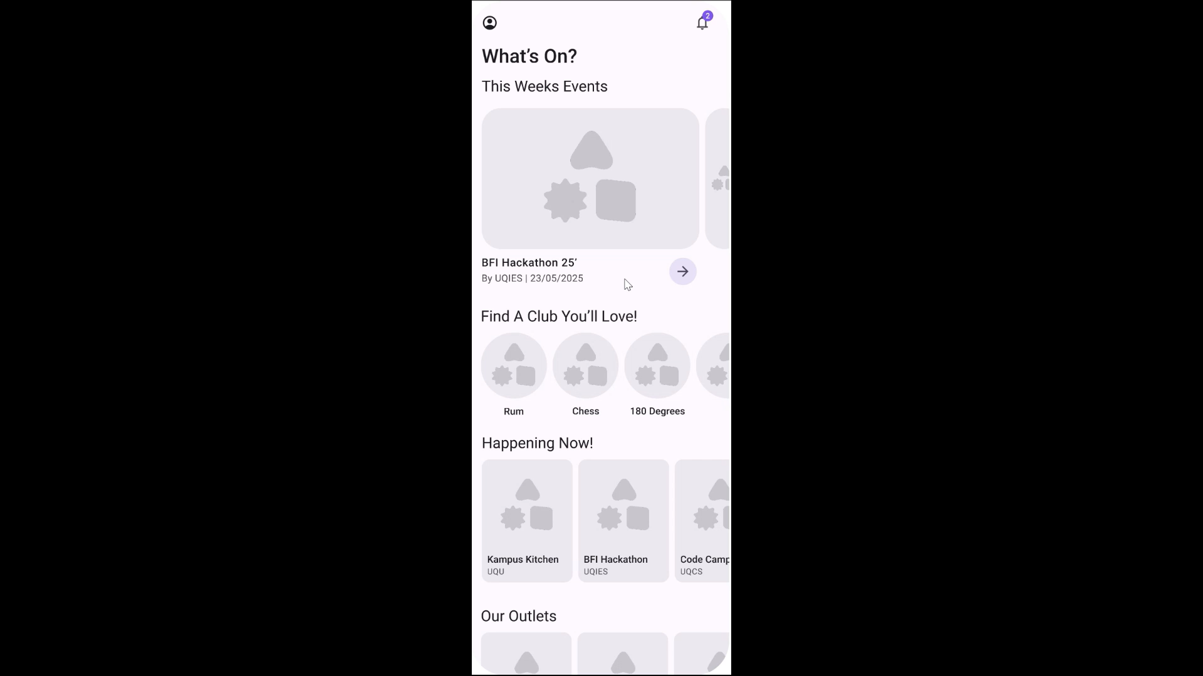
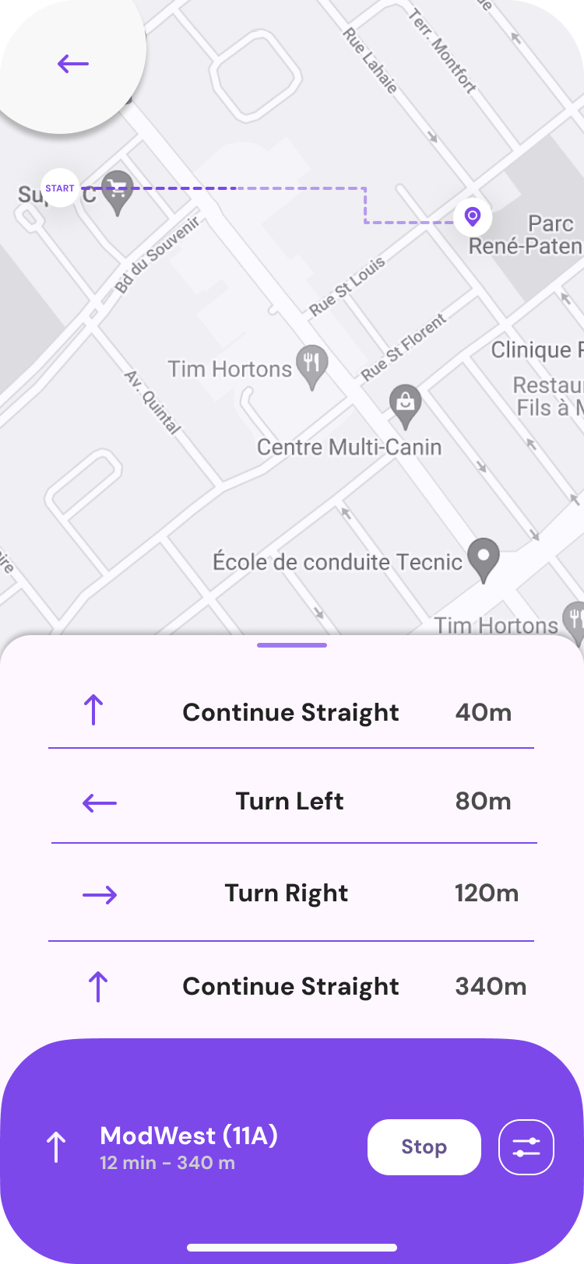
Page Designs
Notes:
Now, here is a real-world example of how our AR navigation works. (20s)

Slide 7
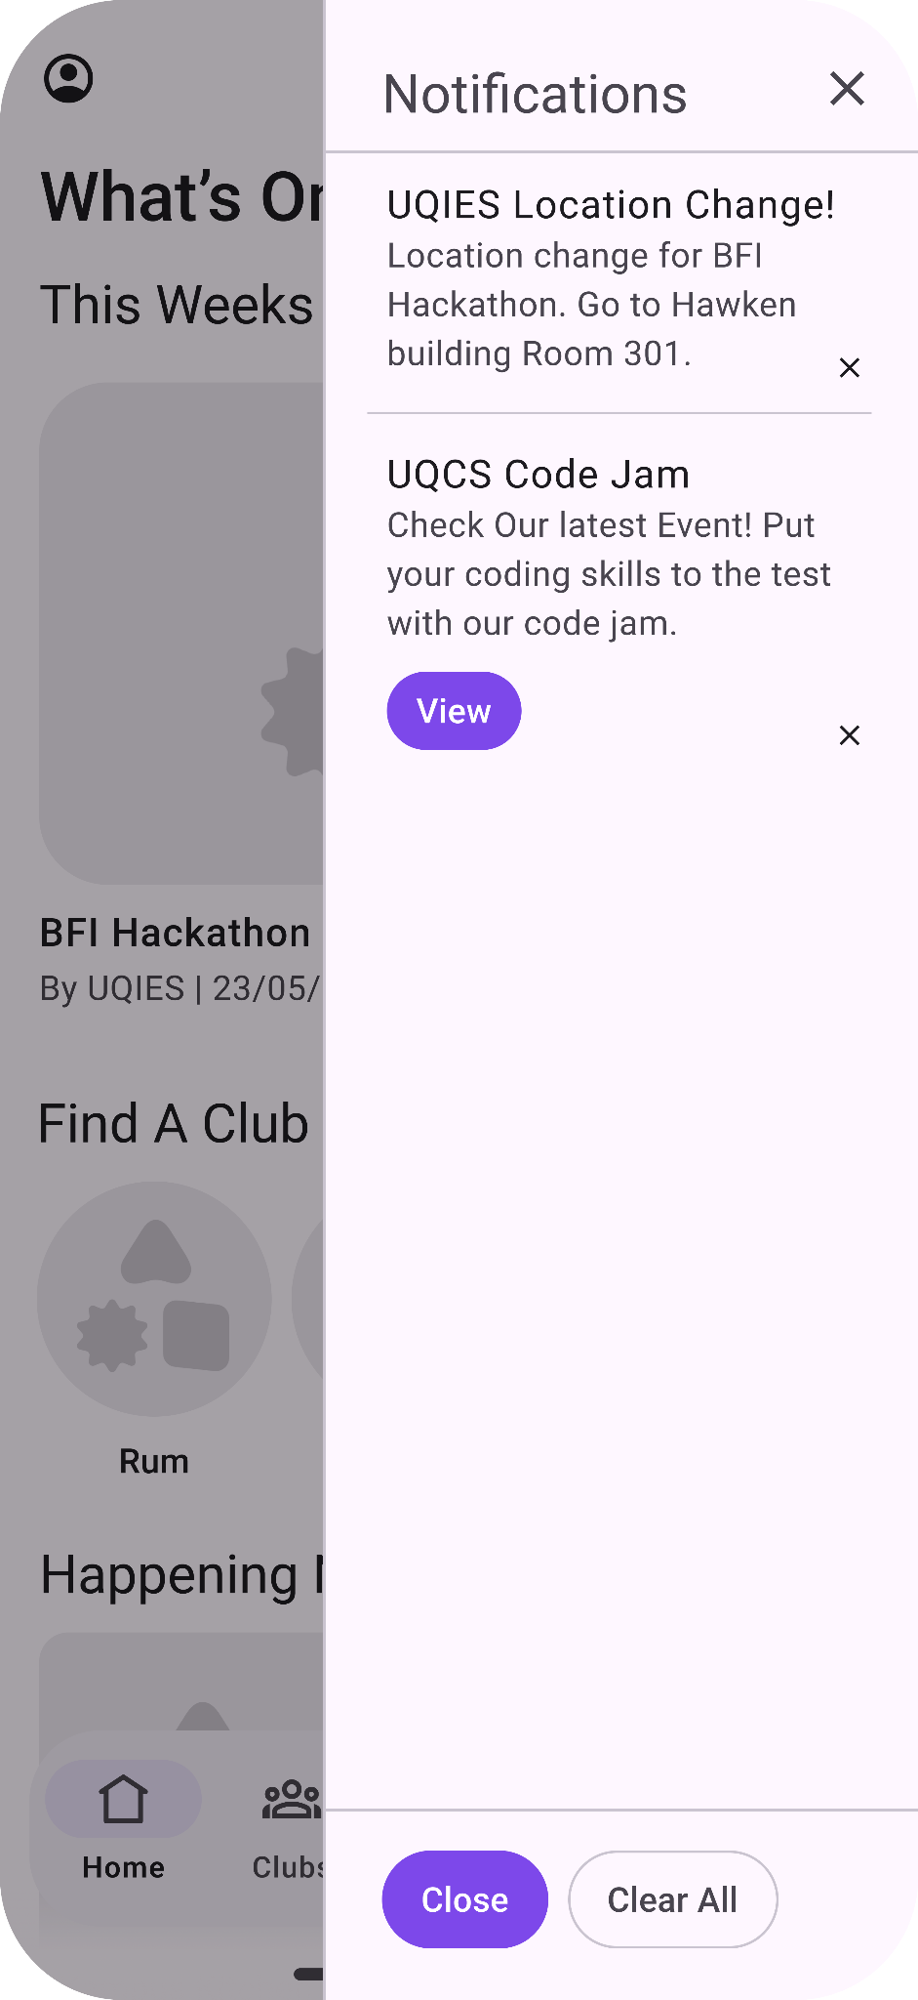
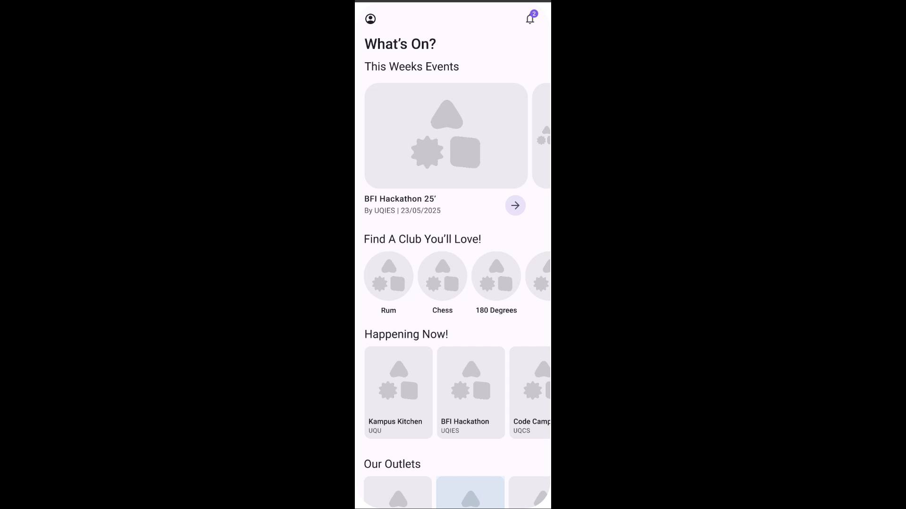
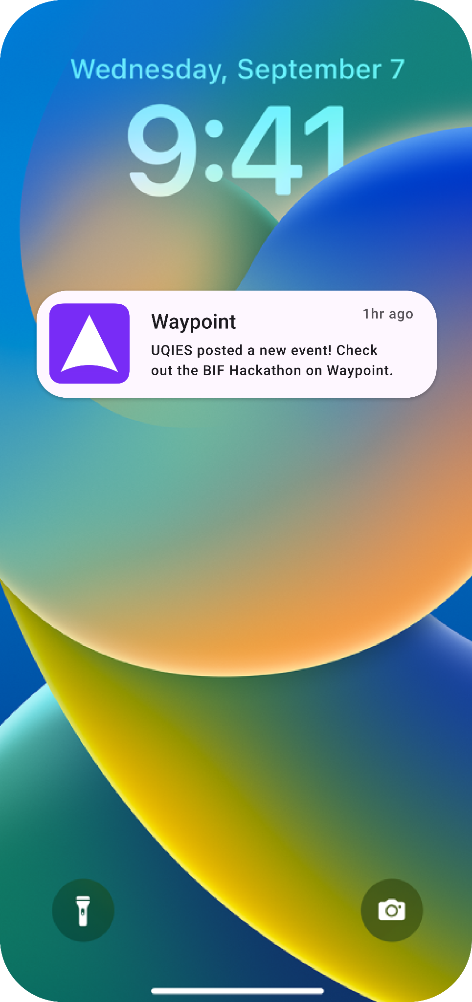
Page Designs
Notes:
And these are all the pages and features dedicated to all the UQU services (15s)

Slide 8
Roadmap
Phase 1
Phase 3
Release
Indoor navigation using SLAM AR
UQU Event and Club pages and Registration
Addition of student timetables and UQU loyalty program
Phase 2
Phase 4
Integration with UQ API data
App Monetization and push notifications implementation
Notes:
Currently the released version of waypoint is just the MVP with no current integration with UQU services. So, these are our future plans to truly make it the UQU Hub over the next 3 months.

Slide 9








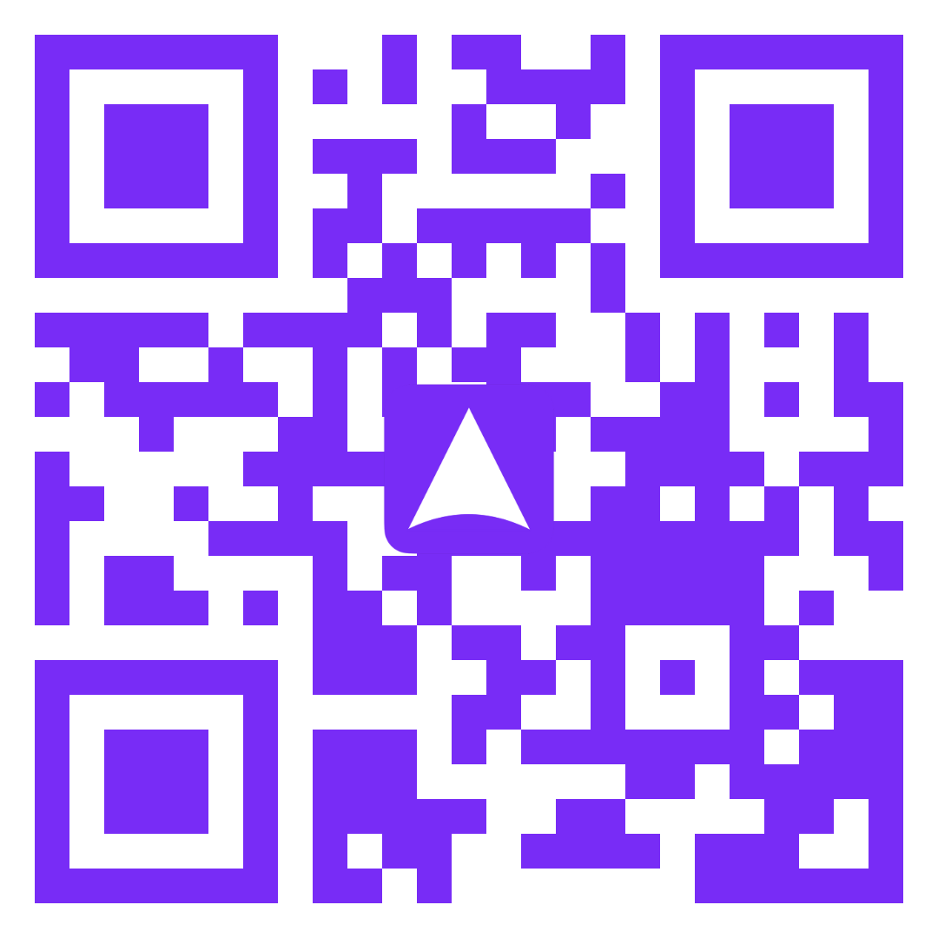








The Technologies
Notes:
Mention how it is a Web-App built on the framework7 platform. Mention it was notably built using Mapbox and AR.js on the webGL and webXR frameworks. And then conclude that is is live now!

Slide 10




Platform Support
Notes:
mention support for all Platforms from Android to Linux (anything that has access to the internet!). Also say how while it is currently published to the web it also can be published to app app stores due to vite and framework7 compiling.

Slide 11
3,700
Source: Google Analytics (uqunion.info)
Students have tried Waypoint!
Notes:
Over this past weekend we have amassed over 3,700 users. And here's what they had to say…

Slide 12
The Impact
62%
81%
76%
Recognition
Participation
Support
Over 62% of students at UQ reported that they do know what UQU does.
81% of students stated they would go to more events because of waypoint.
76% of students would find it easy to integrate with UQU with waypoint
Source: Google Forms
Notes:
Based off surveys with dozens of students and users of Waypoint, this is the impact it had on them. It is undeniable that

Slide 13
Jonathan Chai (Interview)
“I loved using the AR feature to navigate to the Central Library, was very fun to use”
Notes:
The feedback has been overwhelming. As a result of the surveys, students rated the design 4.65/5 and over 71.4% of users said they would recommend it to friends or peers.

Slide 14
Why It Matters
Engagement With UQU
Event/Club Attendance
Campus Experience
Data proves that UQU needs recognition, this is why a UQU app must solve student problems
With simple and secure in-app registration and AR ads it will boost attendence
UQ has so much to offer but can be overwhelming especially to new students
Source: Google Forms, Interviews
Notes:
Use google forms data (familiarity with UQU, would you go to more event, etc.) to reinforce these points.

Slide 15
Cost
Waypoint
MapBox API
Stripe
Est. $50 per day for 50,000 visits
Publication
1.7% + A$0.30 fee on every transaction
$190/year for both IOS and Android
Notes:
Mention how mapbox costs based off data gathered from MVP. while web hosting is free due to being a static webapp, to publish to the mobile stores it would cost $190/year. And stripe fees will be absorbed by clubs as the funds are directly linked to their own stripe account (only fee associated with publishing on the app).

Slide 16
Monetization
Sponsored Placement
AR Event Promotion
AR Ads
Ads that adhere to the surface of buildings in a non-intrusive way. Est. $1,679-8,395/year/business or club
Participating UQ businesses can pay to have sponsored search placements and routes est. $200/year/business
UQ Clubs can pay to have their upcoming events displayed in AR to boost engagement est. $100/event
Notes:
Mention interviews with stores and interview UQU and UQIES to see if clubs would pay to promote events. Mention how much income it would produce. All estimates from interviews with stores and clubs. With sufficient partnerships with businesses or clubs it would make the app profitable

Slide 17
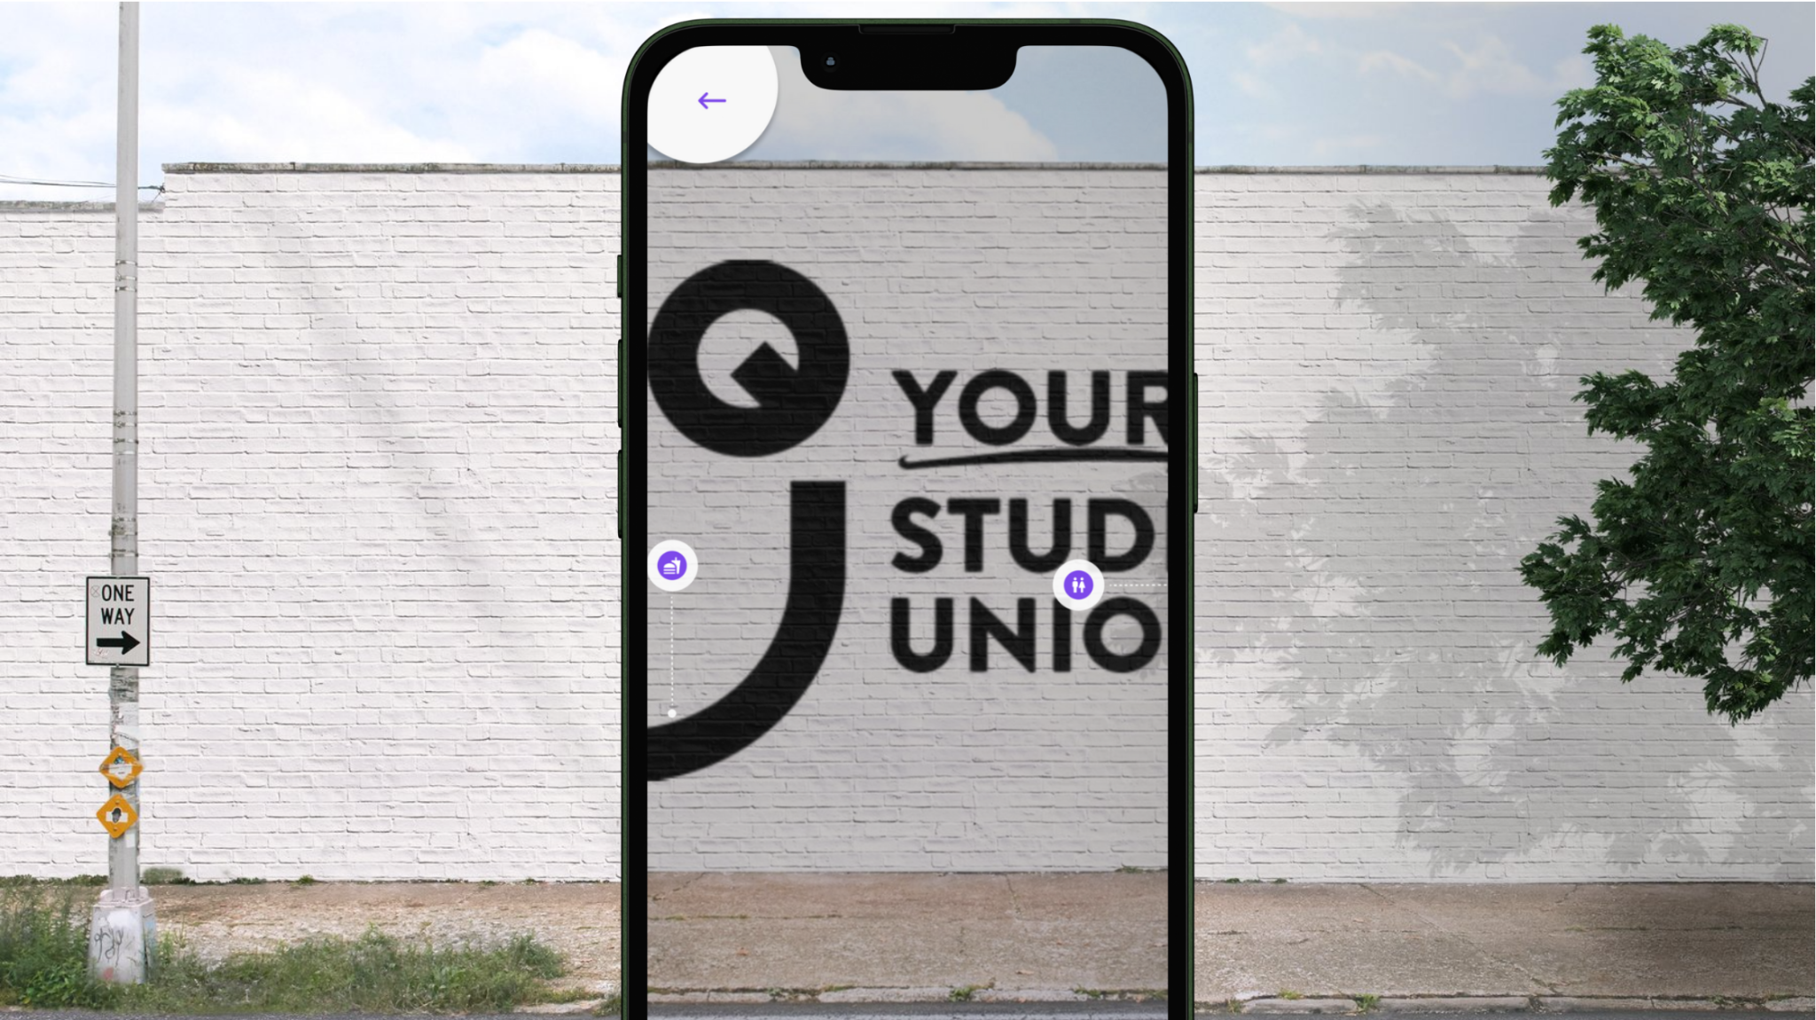
Ads that aren’t intrusive!
Notes:
These AR Ads would be carefully curated to keep the student experience clean, helpful, and relevant.

Slide 18
The Vision
AR Navigation
UQU Rewards
Help students and visitors navigate our campus
Get rewarded for going to the places you love
UQU Hub
AR Promotion
All of UQU in one app!
Find events as you find your next class
Notes:
With Waypoint, UQU won't just be part of student life — it'll be the first thing students discover, love, and remember. It’s time that students have a campus companion.

Slide 19
Questions?
Notes:
Questions?

Slide 20
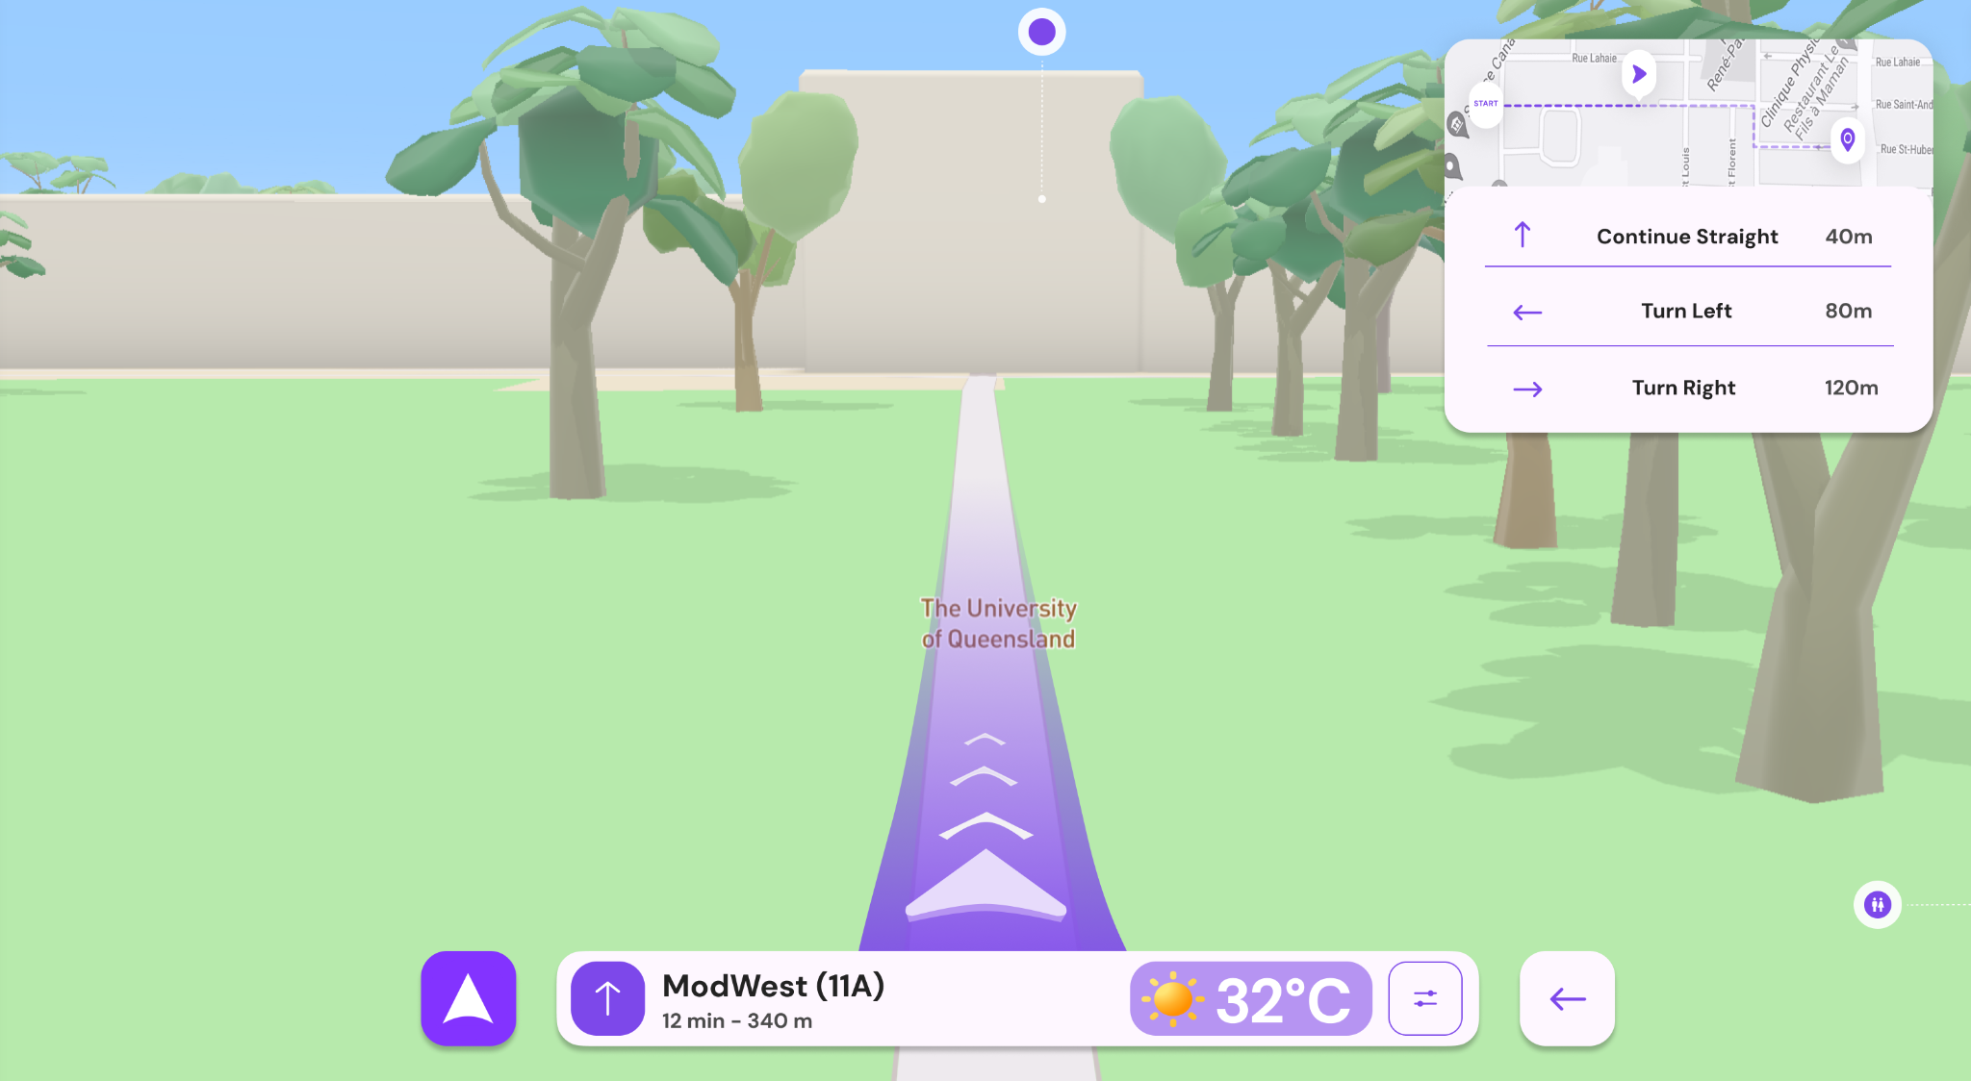
Desktop Mode

